Slide 1
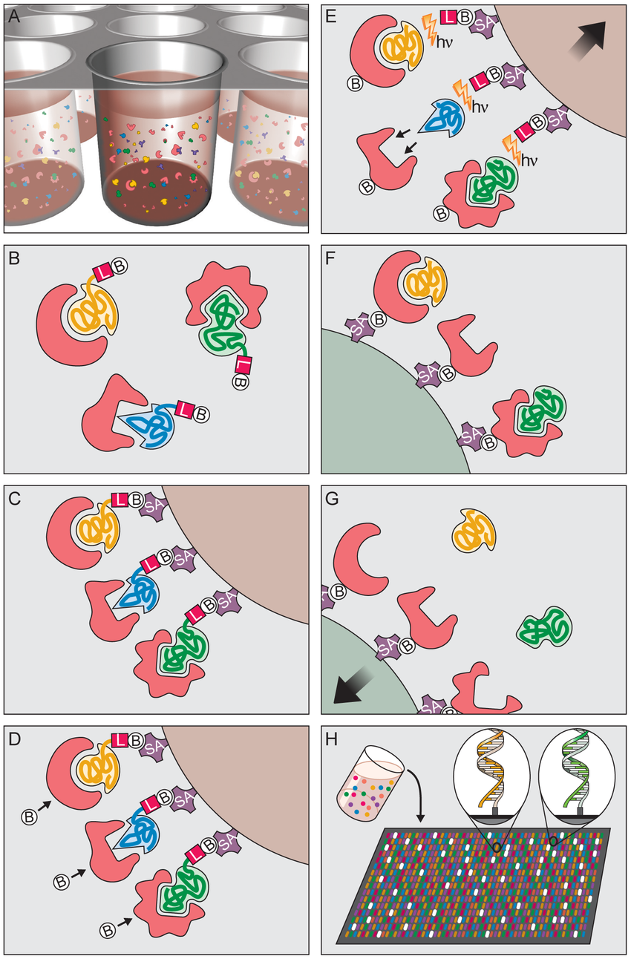
Principle of Multiplex SOMAmer Affinity Assay
Binding. SOMAmers and samples are mixed in 96-well microwell plates and allowed to bind. Cognate and non-cognate SOMAmer-target protein complexes form.
SOMAmer-protein binding: DNA-based SOMAmer molecules (gold, blue, and green) have unique shapes selected to bind to a specific protein. SOMAmers contain biotin (B), a photo-cleavable linker (L) and a fluorescent tag at the 5′ end. Most SOMAmers (gold and green) bind to cognate proteins (red), but some (blue) form non-cognate complexes.
Catch-1. SOMAmers are captured onto a bead coated with streptavidin (SA) which binds biotin. Un-complexed proteins are washed away.
Proteins are tagged with NHS-biotin.
Photocleavage and kinetic challenge. UV light (hν) cleaves the linker and SOMAmers are released from beads, leaving biotin on bead. Samples are challenged with anionic competitor (dextran sulfate). Non-cognate complexes (blue SOMAmer) preferentially dissociate.
Catch-2 SOMAmer-protein complexes are captured onto new avidin coated beads by protein biotin tag. Free SOMAmers are washed away.
SOMAmers are released from complexes into solution at high pH.
Remaining SOMAmers are quantified by hybridization to microarray containing single-stranded DNA probes complementary to SOMAmer DNA sequence, which form a double-stranded helix. Hybridized SOMAmers are detected by fluorescent tags when the array is scanned.

Slide 2
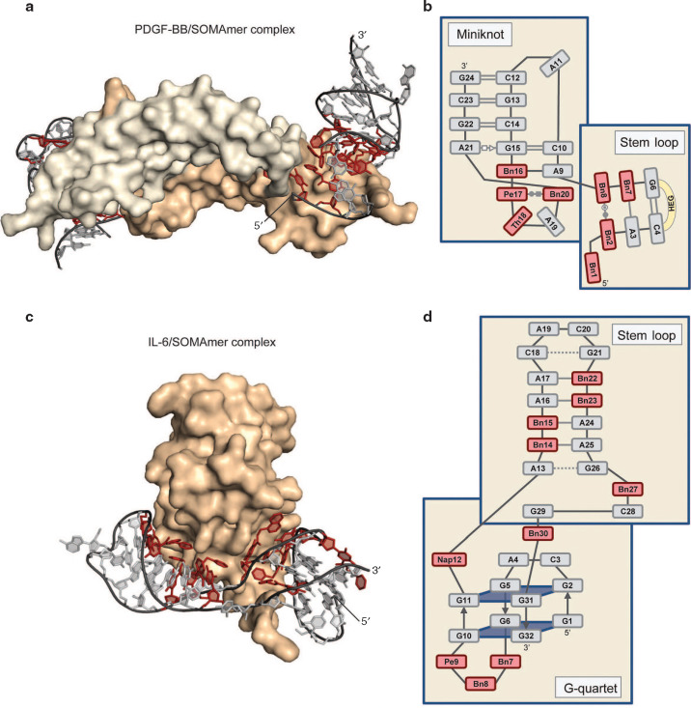

Slide 3
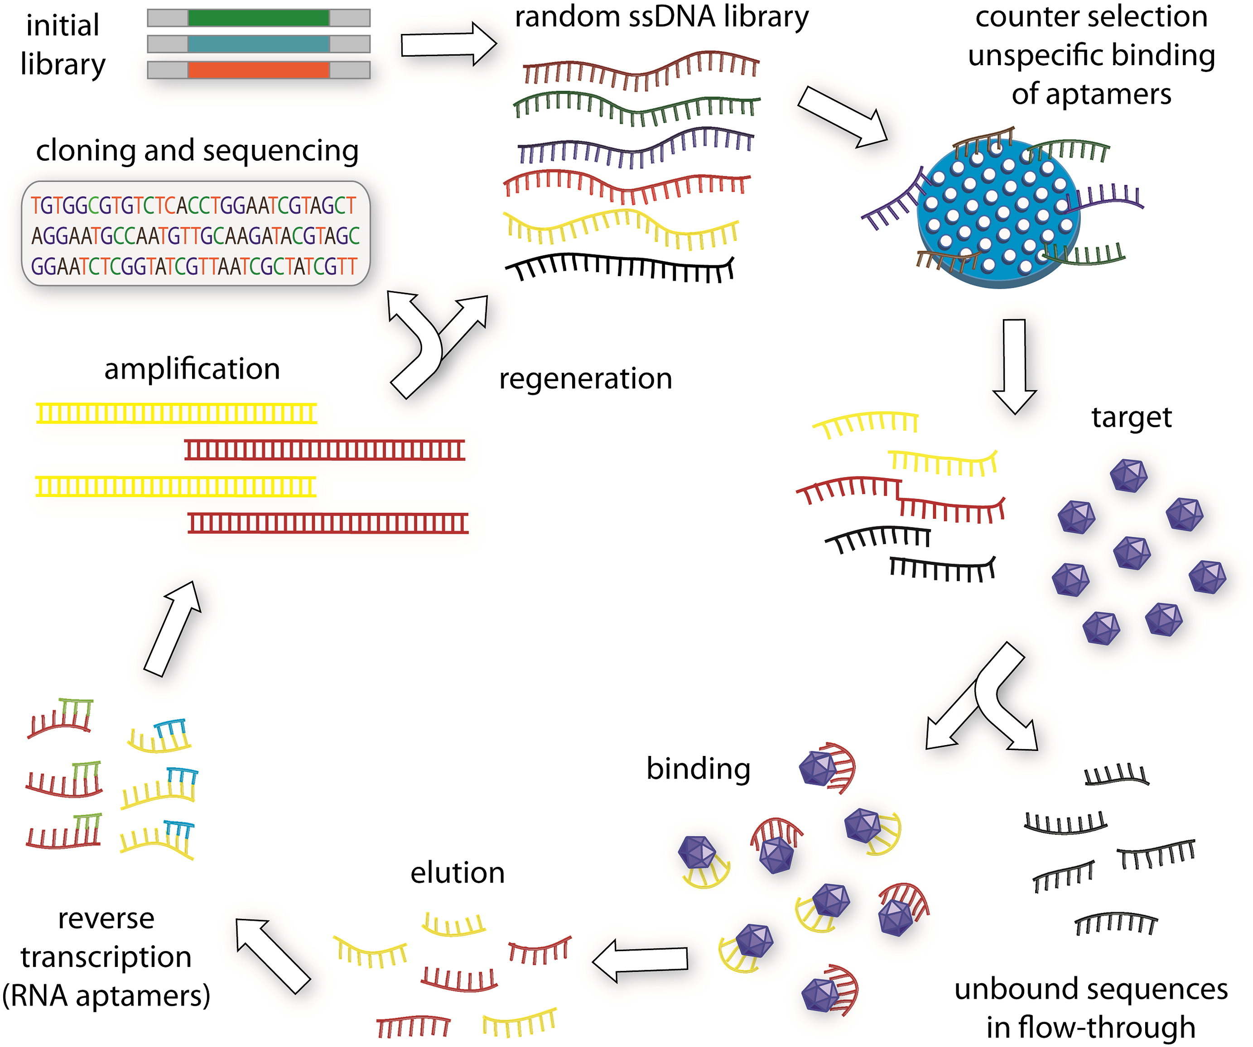
SELEX for Aptamer Selection
https://doi.org/10.1016/j.biotechadv.2015.02.008

Slide 4
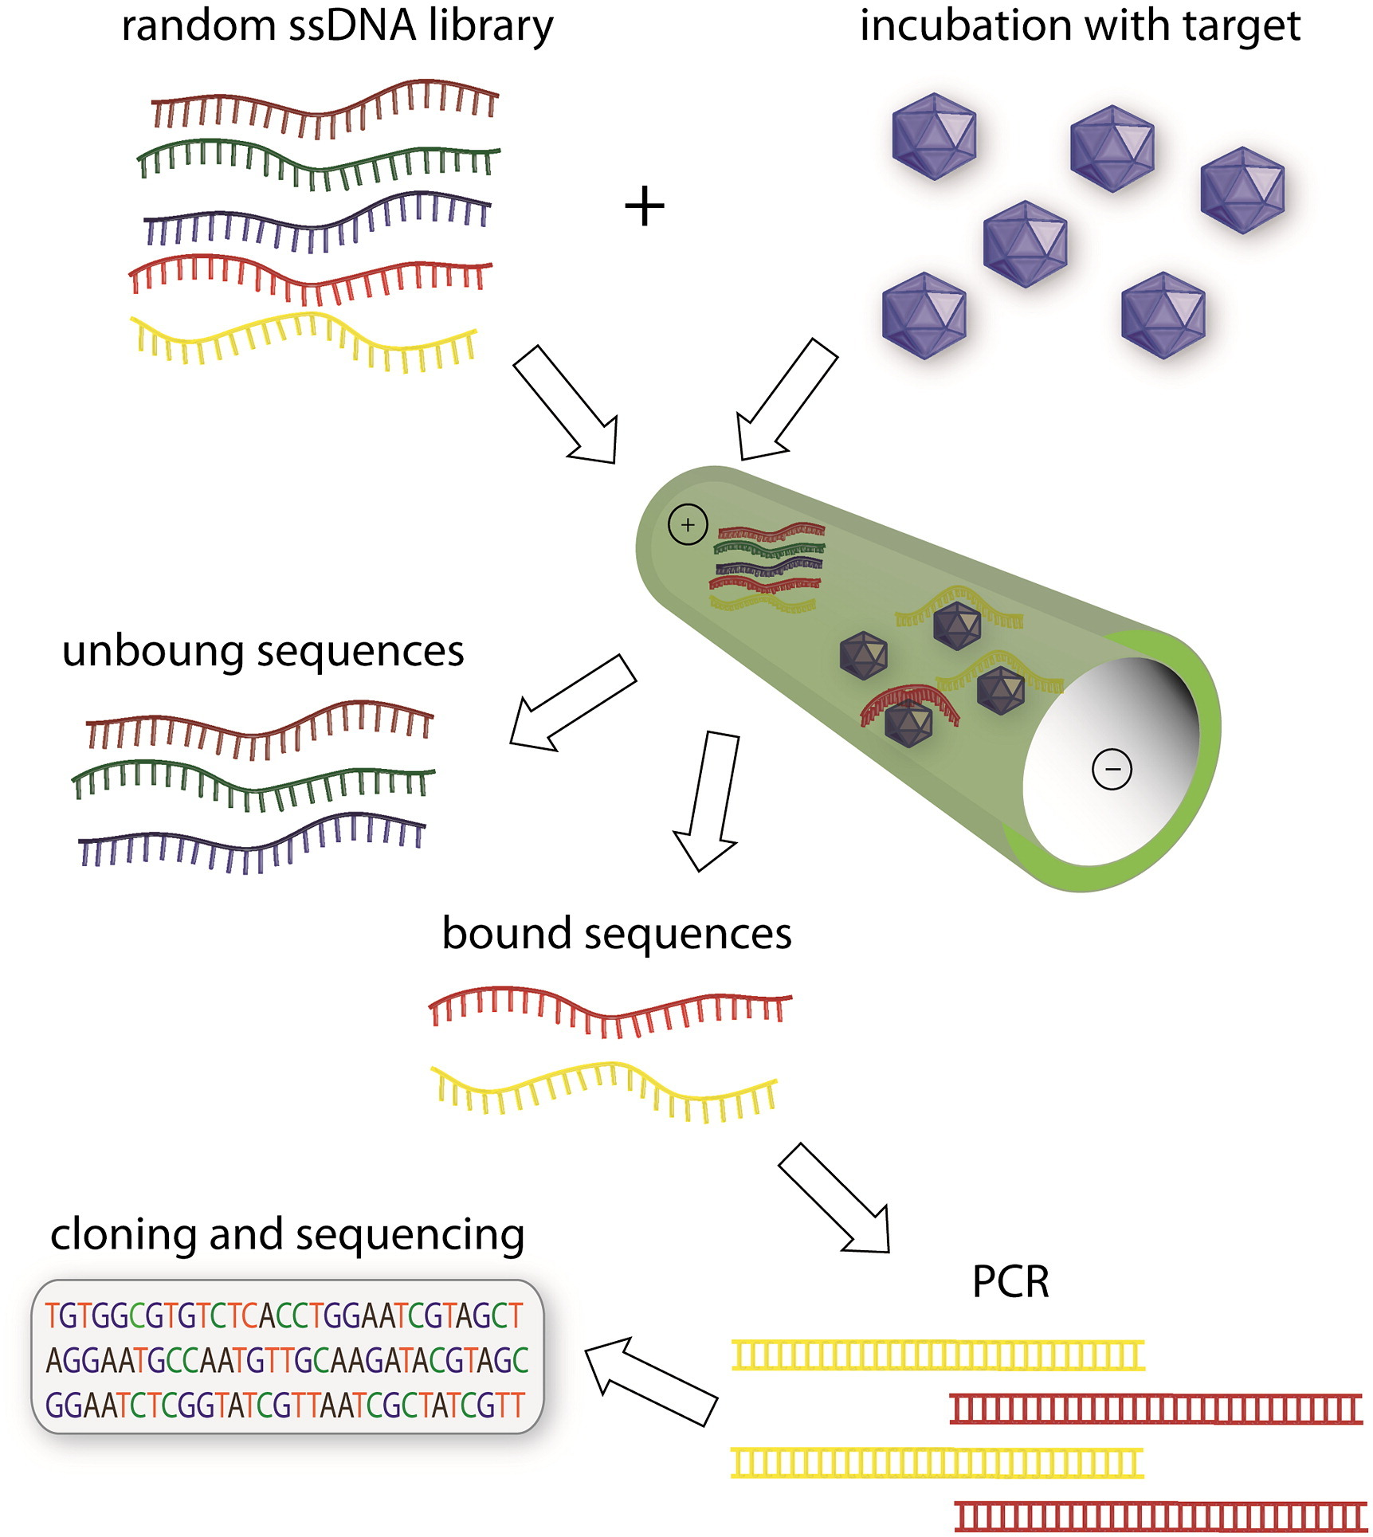
SELEX Using Capillary Electrophoresis
https://doi.org/10.1016/j.biotechadv.2015.02.008

Slide 5
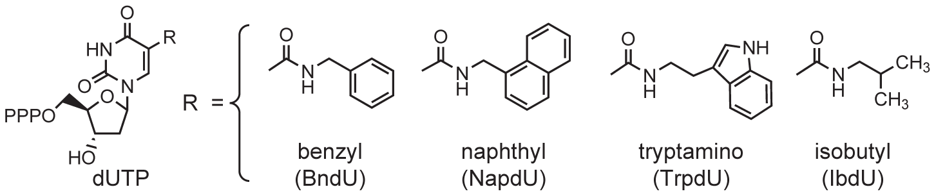
Somologic SOMAmer – Slow Off-rate Modified Aptamers
Notes:
Deoxy uridine triphosphate

Slide 6
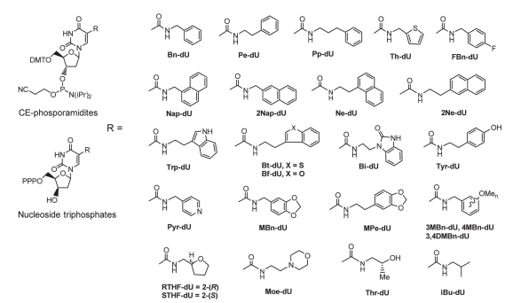
Nucleic Acid Ligands with Protein-Like Side Chains

Slide 7
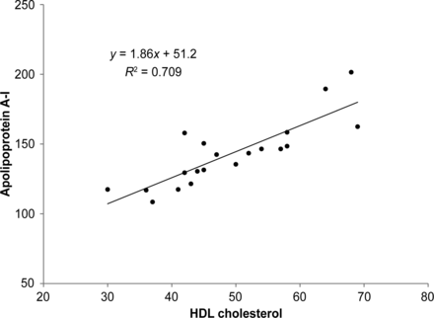
Ngo et al. Aptamer-Based Proteomic Profiling Reveals Novel Candidate Biomarkers and Pathways in Cardiovascular Disease Circulation 2016
Measured 1129 proteins using Somoscan technology in plasma
UW Assays
Somologic ApoA1 assay doesn’t correlate with HDL
retinol-binding protein 4 was not associated with diabetes

Slide 8
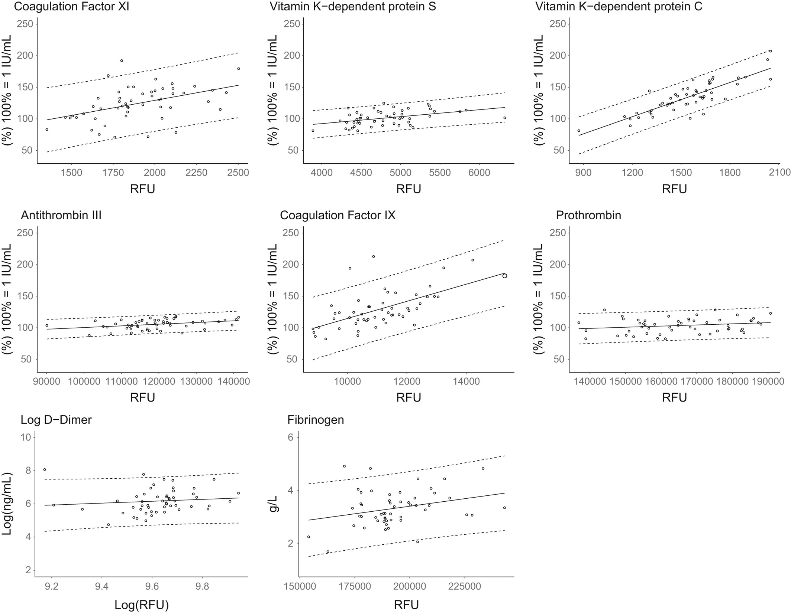
Faquil et al. Agreement of aptamer proteomics with standard methods for measuring venous thrombosis biomarkers
Measured proteins using Somoscan technology in plasma
626 Patients
Common venous thrombosis biomarkers measured using laboratory tests
“SomaScan platform is not interchangeable with validated laboratory instruments for the VTE markers in our study. Therefore, caution is needed when applying SomaScan measurements for hypothesis-driven VTE studies using these markers.”

Slide 9
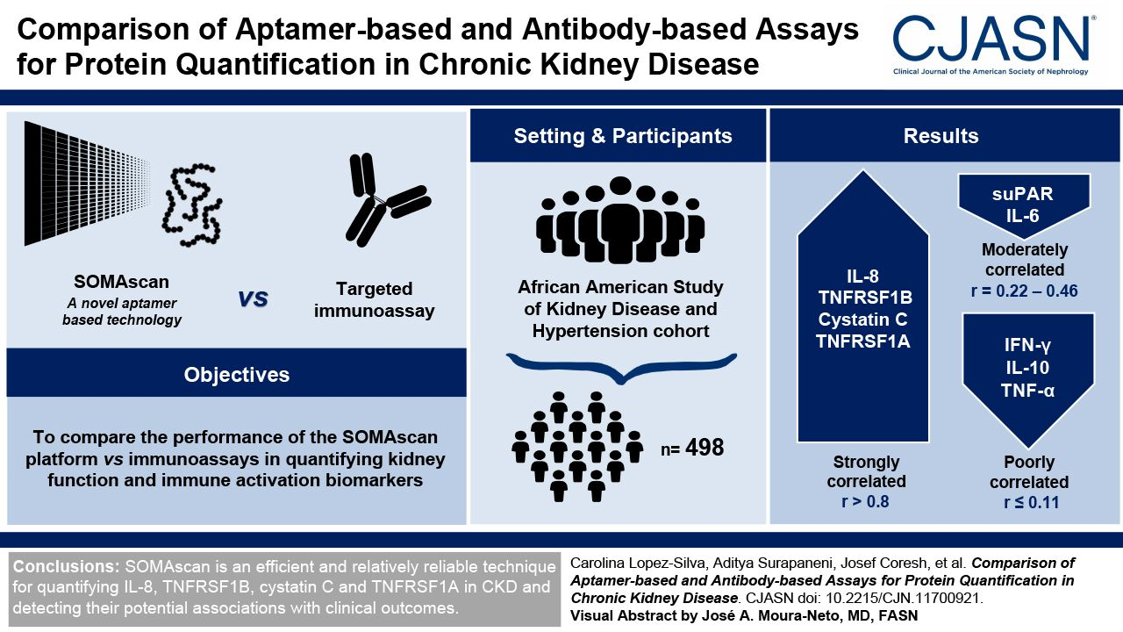
Lopez-Silva et al. Comparison of Aptamer-Based and Antibody-Based Assays for Protein Quantification in Chronic Kidney Disease
Measured 7000 proteins using Somoscan technology in plasma
498 Patients
Gold Standard Assays Performed
Six biomarkers (IL-8, soluble TNF receptor superfamily member 1B [TNFRSF1B], cystatin C, soluble TNF receptor superfamily member 1A [TNFRSF1A], IL-6, and soluble urokinase-type plasminogen activator receptor [suPAR]) had non-negligible correlations (r=0.94, 0.93, 0.89, 0.85, 0.46, and 0.23, respectively) between SOMAscan and immunoassay measurements, and three (IL-10, IFN-γ, and TNF-α) were uncorrelated (r=0.08, 0.07, and 0.02, respectively). Of the six biomarkers with non-negligible correlations, TNFRSF1B, cystatin C, TNFRSF1A, and suPAR were negatively correlated with measured GFR and associated with higher risk of kidney failure. IL-8, TNFRSF1B, cystatin C, TNFRSF1A, and suPAR were associated with a higher risk of mortality via both methods. On average, immunoassay measurements were more strongly associated with adverse outcomes than their SOMAscan counterparts.

Slide 10
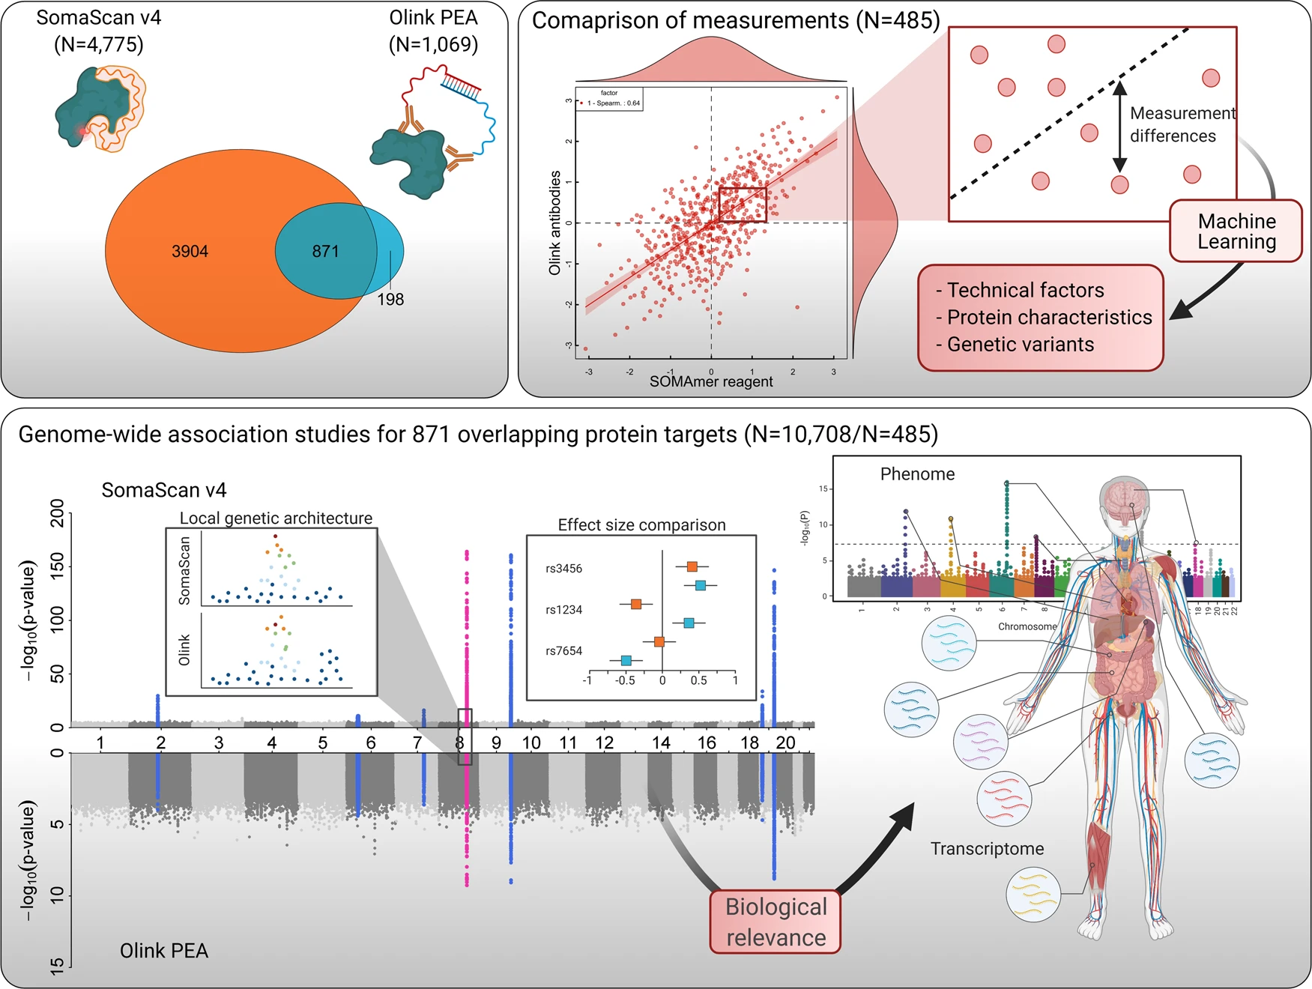
Pietzner et al. Synergistic insights into human health from aptamer- and antibody-based proteomic profiling
Only 1/3 of the measurements are corroborated with Olink.
“A common pattern among results not shared between both assays related to the reliance of the SomaScan assay to a conserved protein structure to enable aptamer binding”
“the lack of full technical details of the assays that are not in the public domain as they are commercially sensitive and general methodological differences between the assays did not permit a more rigorous assessment of non-biological factors. This includes the similarity of synthetic peptides used to select binding reagents or a measure of binding affinity for antibodies, which might likely yield additional insights into possible differences.”

Slide 11
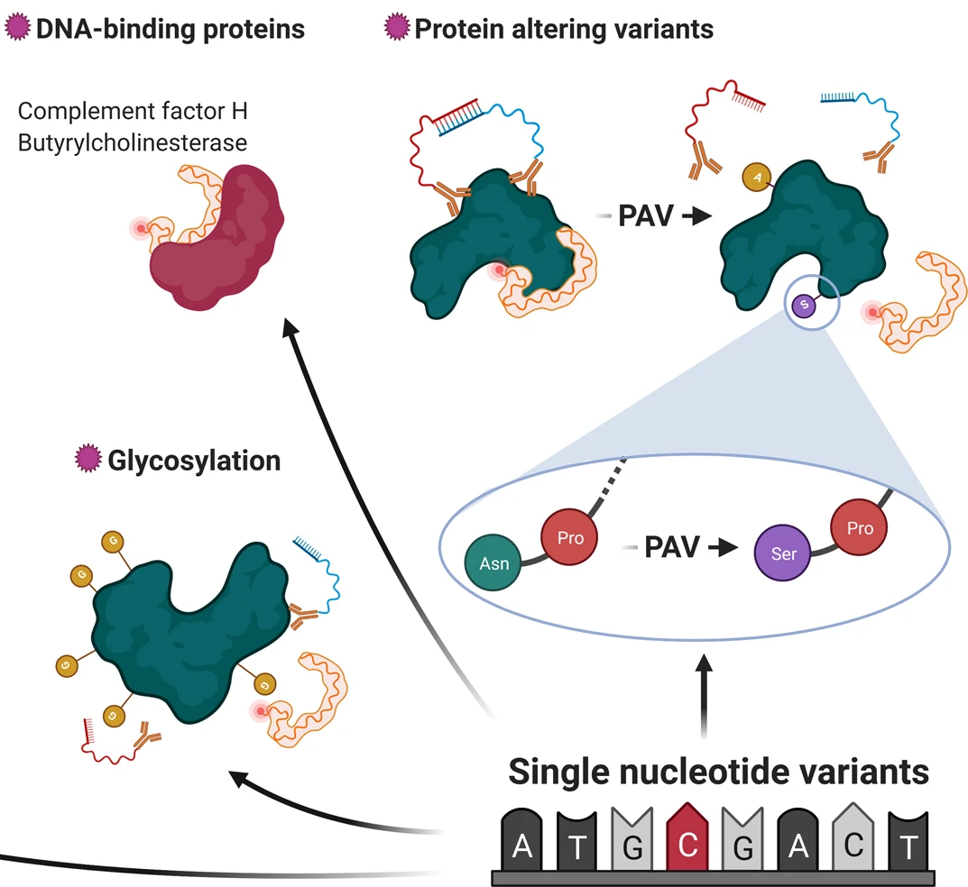

Slide 12
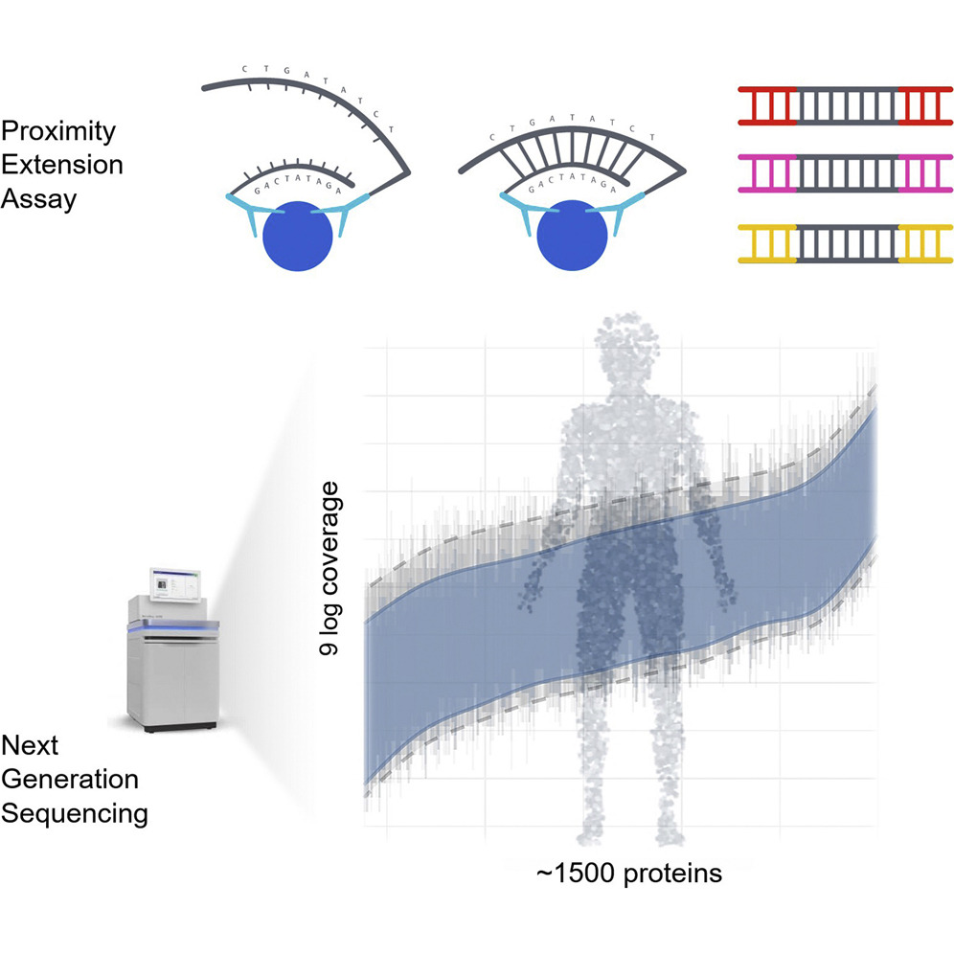
Olink is a Proximity Extension Sandwich Assay

Slide 13
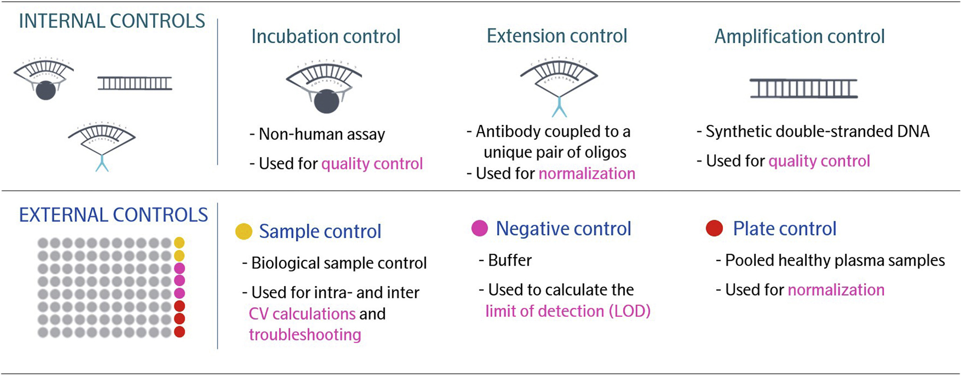

Slide 14
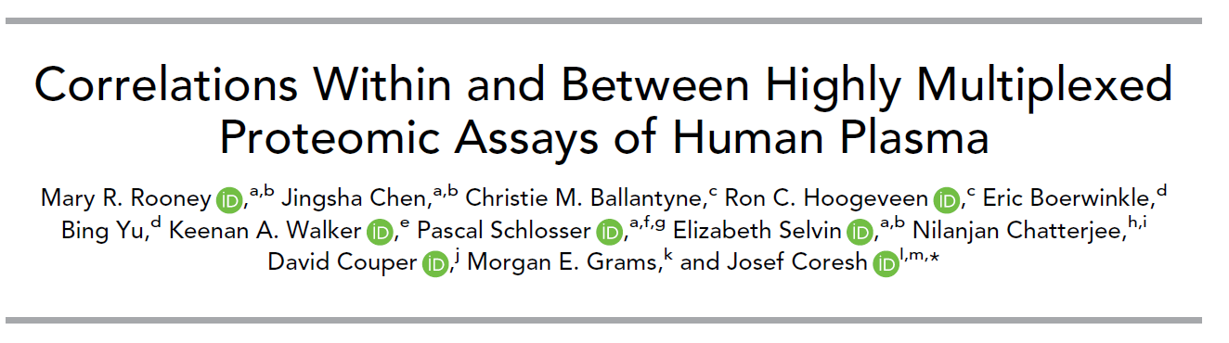

Slide 15
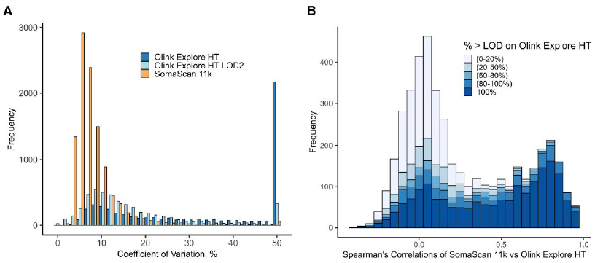
Comparison of Precision and Accuracy Between Olink and SomaScan
Fig. 1. (A and B), Summary of within-platform precision and between-platform correlations among 102 ARIC Study participants (2011–2013). (A), Precision of proteins measured in duplicate on the SomaScan 11k (10 778 assays) and on the Olink Explore HT (5420 assays) before and after imputing values below LOD to the LOD divided by 2 (LOD2). CVs were capped at 50% for the display of the histogram; (B), Histogram of Spearman correlations for the 4443 overlapping protein assay comparisons on the SomaScan 11k and Olink Explore HT platforms, according to the percentage of samples with protein values above the Olink Explore HT LOD. There were 1841 overlapping Olink proteins with 100% samples with protein values above the LOD, 533 proteins with [80%–100%), 261 proteins with [50%–80%), 407 proteins with [20%–50%), 1399 with less than 20% above the LOD; 2 proteins were missing an Olink LOD. There were 4194 overlapping proteins with 100% samples with protein values above the SomaScan LOD, 216 proteins with [80%–100%), 18 proteins with [50%–80%), 8 proteins with [20%–50%), and 7 with [0–20%) above the LOD.
Rooney et al, Clinical Chemistry 2025
Notes:
Summary of within-platform precision and between-platform correlations among 102
ARIC Study participants (2011–2013). (A), Precision of proteins measured in duplicate on the SomaScan 11k
(10 778 assays) and on the Olink Explore HT (5420 assays) before and after imputing values below LOD to
the LOD divided by 2 (LOD2). CVs were capped at 50% for the display of the histogram; (B), Histogram of
Spearman correlations for the 4443 overlapping protein assay comparisons on the SomaScan 11k and Olink
Explore HT platforms, according to the percentage of samples with protein values above the Olink Explore
HT LOD. There were 1841 overlapping Olink proteins with 100% samples with protein values above the
LOD, 533 proteins with [80%–100%), 261 proteins with [50%–80%), 407 proteins with [20%–50%), 1399
with less than 20% above the LOD; 2 proteins were missing an Olink LOD. There were 4194 overlapping
proteins with 100% samples with protein values above the SomaScan LOD, 216 proteins with [80%–
100%), 18 proteins with [50%–80%), 8 proteins with [20%–50%), and 7 with [0–20%) above the LOD.

Slide 16
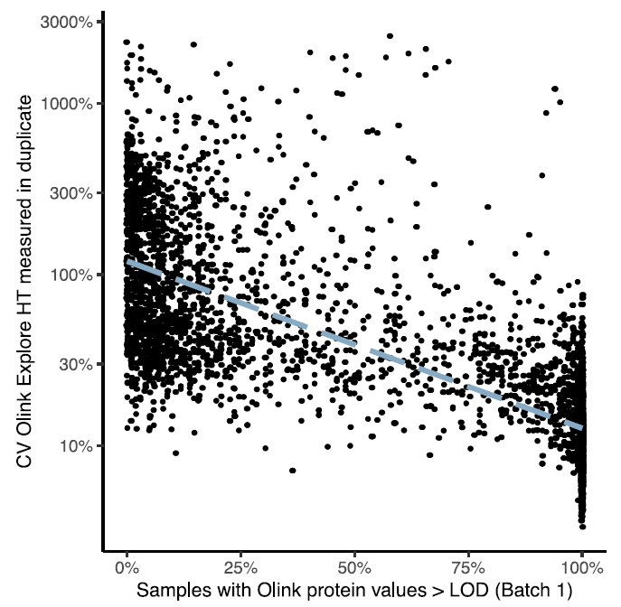
Scatterplot of the percentage of participants with protein values above the LOD vs CV (log2 scale) on the Olink Explore HT
Scatterplot of the percentage of participants with protein values above the LOD vs CV (displayed on the log2 scale) on the Olink Explore HT among 102 ARIC participants. Dashed line represents a linear regression of the percentage of participants with protein values above the LOD and the CV for the Olink Explore HT (log2 transformed).
Discussion: “In our study, we wouldhave excluded 2974 (55%) Olink Explore HT proteins with low detection (i.e., protein below LOD on the majority of samples). Researchers should thoughtfully consider the different methods for handling measurements below the LOD in the context of their own studies.”
Rooney et al, Clinical Chemistry 2025
Notes:
Scatterplot of the percentage of participants with protein values above the LOD vs CV (displayed
on the log2 scale) on the Olink Explore HT among 102 ARIC participants. Dashed line represents a linear
regression of the percentage of participants with protein values above the LOD and the CV for the Olink
Explore HT (log2 transformed).

Slide 17
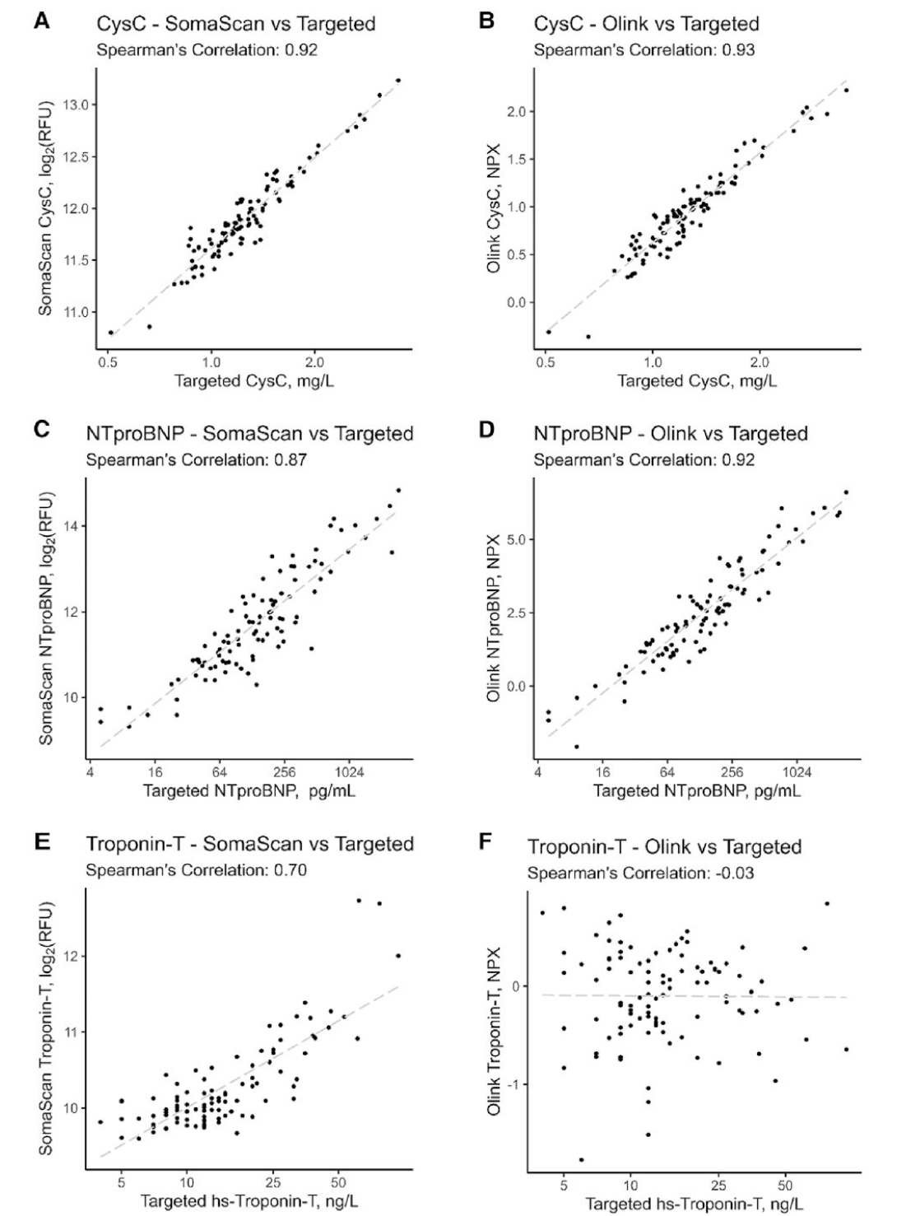
Fig. 3. (A-F), Correlations of SomaScan 11k and Olink Explore HT with targeted immunoassays
(cystatin-C, NTproBNP, troponin-T) at visit 5. All values are provided on the log2 scale. The Olink validation LOD (on the Normalized Protein eXpression scale) was −6.17 for cystatin-C (OID45345, 100% samples above LOD on Olink), 0.0074 for NT-proBNP (OID44822, 95% samples above LOD on Olink), and 1.35 for troponin-T (OID40669, 0% samples above LOD on Olink). The SomaScan 11k validation LOD was 6.09 for cystatin-C (SeqId-2609-59, 100% samples above LOD on SomaScan), 8.34 for NT-proBNP (SeqId-7655-11, 100% samples above LOD on SomaScan), and 8.16 for troponin-T (SeqId-5315-22, 100% samples above LOD on SomaScan).

Slide 18
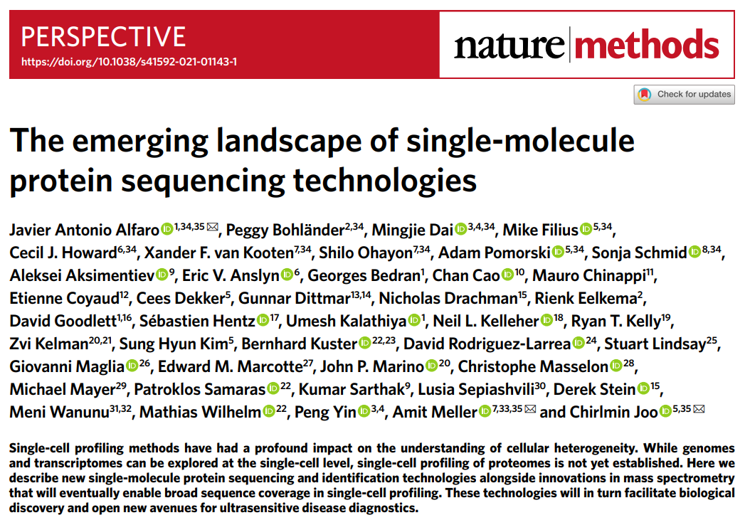
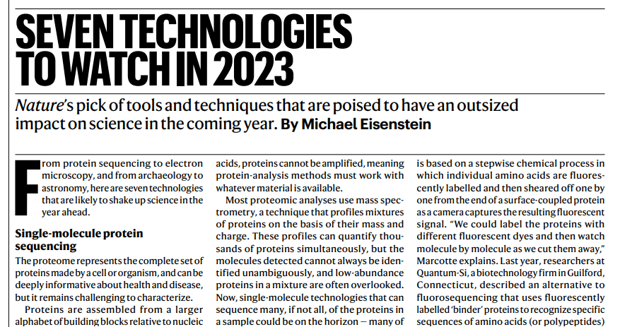
Single-Molecule Protein Sequencing Methods

Slide 19
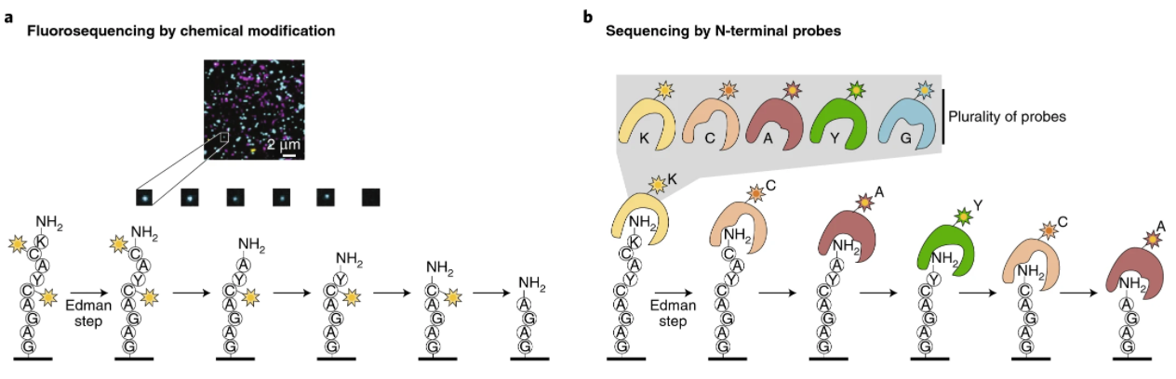
Several Single Molecule Methods are Based on N-terminal Sequencing
Example Technologies
Quantum-Si
Glyphic Biotechnologies
Erisyon
Alfaro et al. Nature Methods 2021

Slide 20
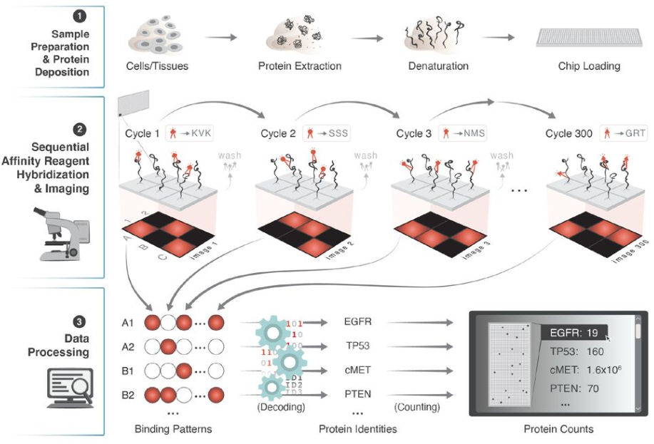
Single-molecule protein identification using multi-affinity protein binding reagents
Nautilus Biotechnology
Egertson et al, Biorxiv, 2021

Slide 21
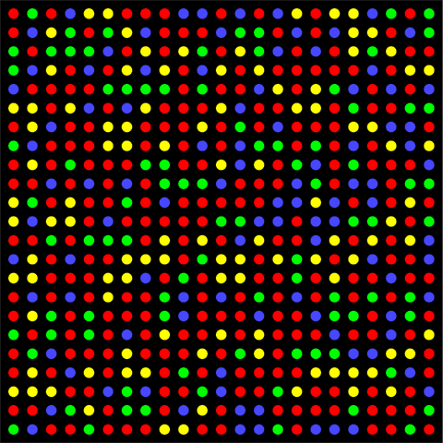
How much better do proteomics methods need to be?
Proteomics is Hard:
400,000 mRNA molecules per cell = 40 million reads
Average transcript at ~5-10 copies
10,000,000,000 protein molecules per cell = 1 trillion reads
Average protein at 10⁴ to 10⁵ copies
Fluorescent wavelength = 200 – 750 nm
Leads to a practical density of ~1 µm
1 million reads: 1 mm²
100 million reads: 1 cm²
10 billion reads: 10 cm²
1 trillion reads: 1 m²
Scaling in Powers of 10 is Hard

Slide 22
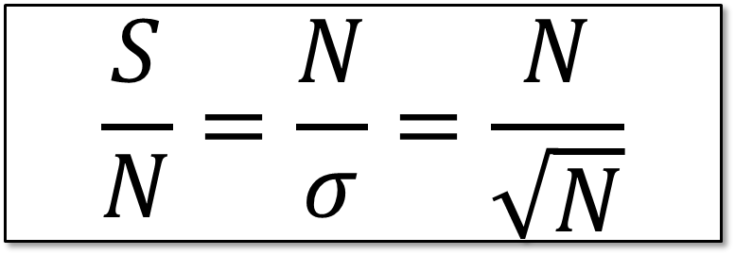
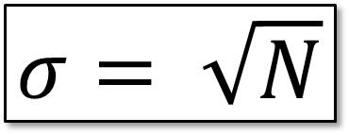
Why do RNA-Seq Methods Perform 100 reads for every mRNA molecule?
100 counts is the LLOQ for methods that are “shot noise limited”
Shot noise (aka Poisson noise, counting noise): Random counting variations (often associated with a current). The higher the counts, the larger the shot noise.
$$σ= \sqrt{N}$$
$$\frac{S}{N}=\frac{N}{σ}=\frac{N}{\sqrt{N}}$$

Slide 23
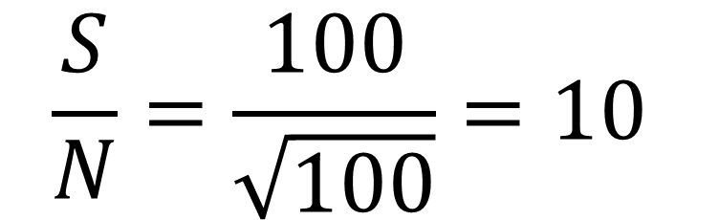
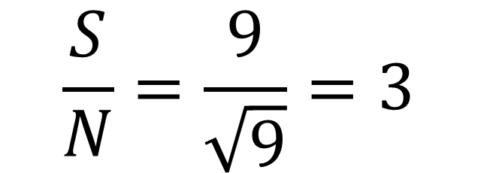
Why do RNA-Seq Methods Perform 100 reads for every mRNA molecule?
100 counts is the LLOQ for methods that are “shot noise limited”
Shot noise (aka Poisson noise, counting noise): Random counting variations (often associated with a current). The higher the counts, the larger the shot noise.
Limit of Detection (LOD)
Lower Limit of Quant (LLOQ)
$$\frac{S}{N}=\frac{9}{\sqrt{9}}=3$$
$$\frac{S}{N}=\frac{100}{\sqrt{100}}=10$$

Slide 24
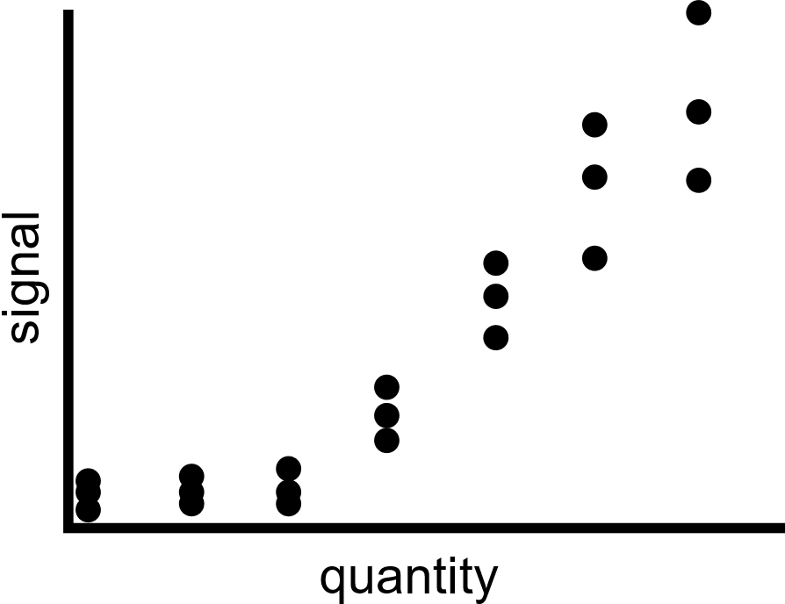
True assessment of LOD and LLOQ Requires Assessment of Background
LLOQ
LOD
signal
quantity

Slide 25
True assessment of LOD and LLOQ Requires Assessment of Background
LLOQ
LOD
signal
quantity
Sample Matrix
Matched matrix

Slide 26
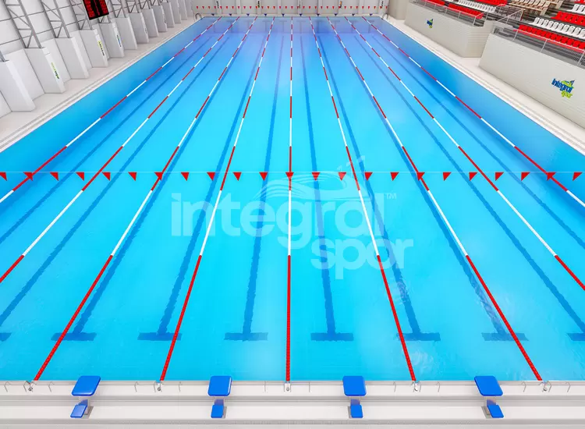
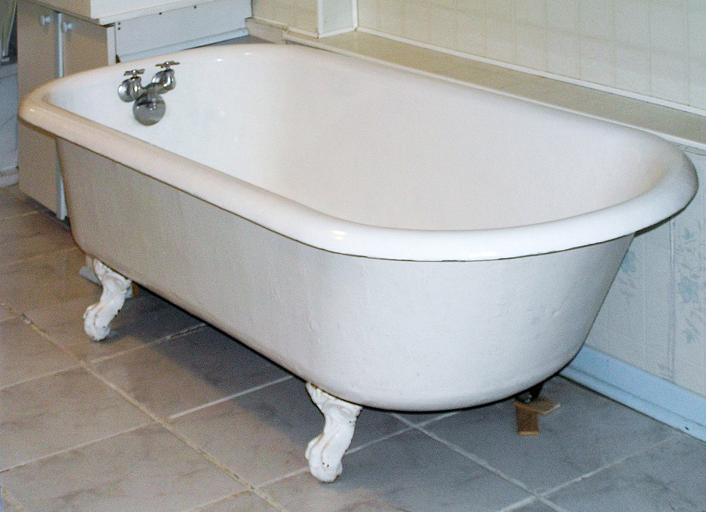
Measuring the volume of a swimming pool
2.5 million liters (proteome)
80-100 liters (transcriptome)

Slide 27
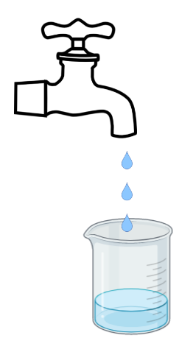
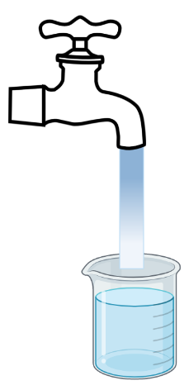
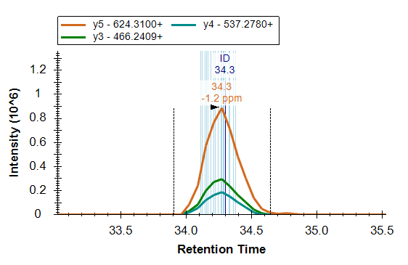
Instead of Counting in Space – Count in Time
Average Transcript is present in ~5-10 copies per cell
Average Protein is present in 10⁴-10⁵ copies per cell
A
A
A
X 10⁵
A
A
A
A
A
A
A
A
A
A
A
A
A
A
A
A
A
A
A
A
A
A
A
A
A
A
A
Time

Slide 28
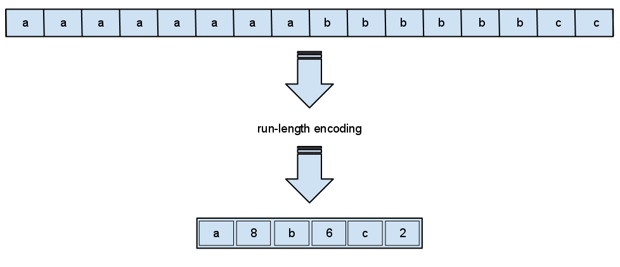
LC-MS/MS is a Lossless Single Molecule Compression Method
Single Molecule Counting
LC-MS/MS
A
A
A
A
A
A
A
A
A
A
A
A
A
A
A
A
A
A
x8
A
A
A
A
A
A
A
A
A
A
A
A
A
A
A
A
A
A
A
A
A
A
A
A
A
A
A

Slide 29
Do we really want to count one ion/one molecule at a time?
LC-MS and GC-MS have used pulse counting detectors in the past
Largely disappeared in favor of ion current measurements
Do we care if we measure 1 ion every nanosecond or 10⁶ ions every millisecond?
If we need to measure 1000x more ions
a single ion method will then need to measure 1 ion every picosecond.
an ion current method will measure 10⁶ ions every microsecond or 10⁹ ions every millisec

Slide 30
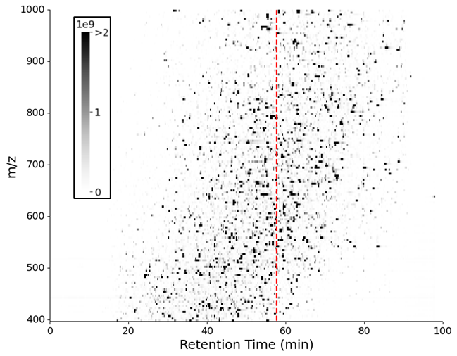
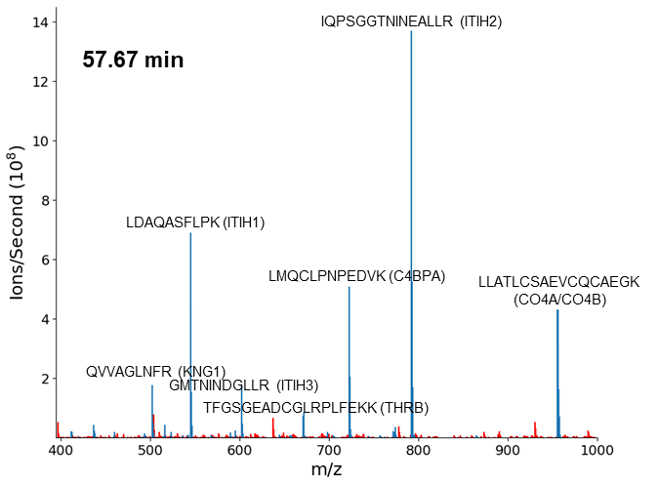
Aggregating peptides and counting in bulk

Slide 31
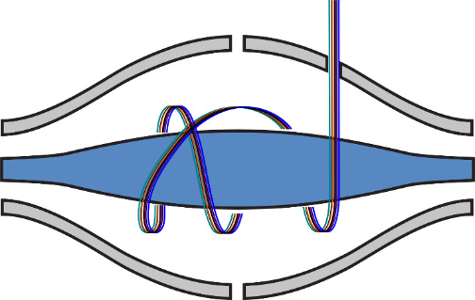
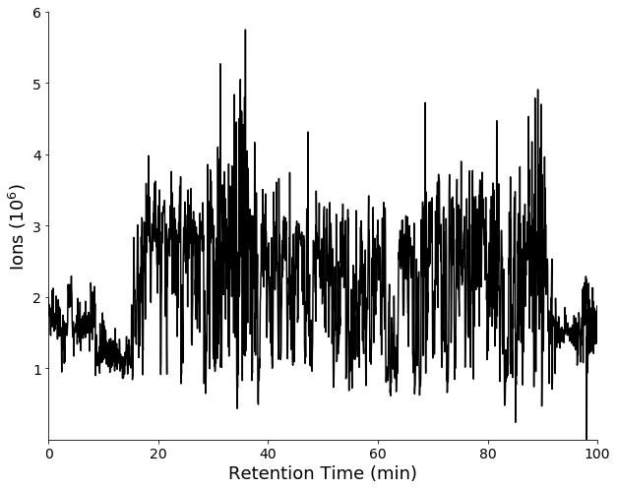
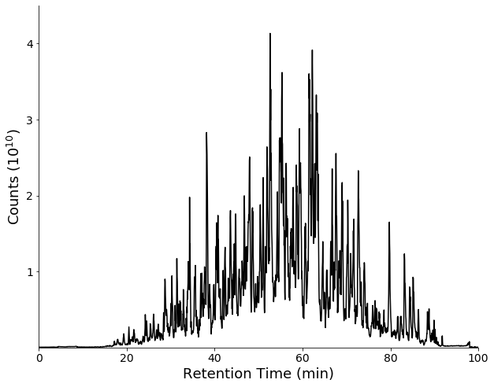
Instead of Counting in Space – Count in Time
We Can Count:
>500,000 ions in 30-60 msec
30 million ions/min
1.8 billion ions/hour
<$100 per hour
Normalize per time.
Counts (ions/sec)
Analogous to RPKM or TPM normalization
Total # of ions: 5,057,320,876
Total TIC: 10,523,443,416,667

Slide 32
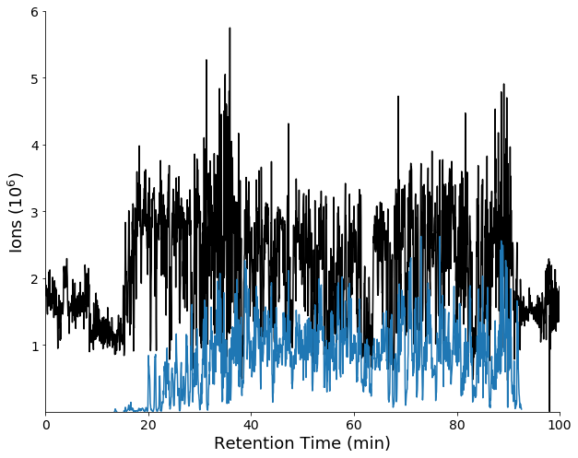
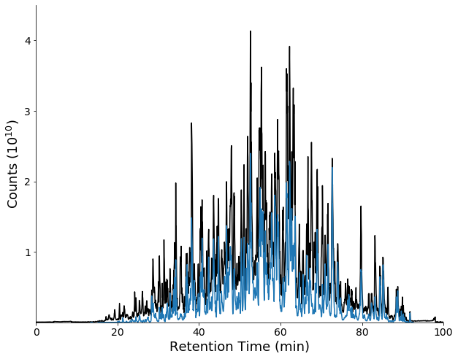
Instead of Counting in Space – Count in Time
We Can Count:
>500,000 ions in 30-60 msec
30 million ions/min
1.8 billion ions/hour
<$100 per hour
Normalize per time.
Counts (ions/sec)
Analogous to RPKM or TPM normalization
Total # of ions: 5,057,320,876
Ions mapped to peptides: 1,222,192,892
24.2% of the ions
Total TIC: 10,523,443,416,667
TIC Mapped: 4,883,887,856,314
46.4% of the signal
LC-MS is More Efficient at Counting Peptides than Illumina is at Counting Nucleotides

Slide 33
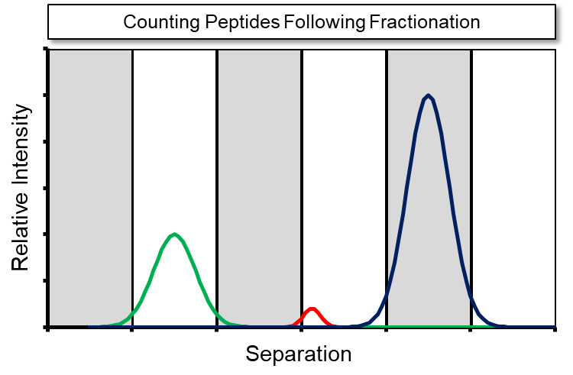
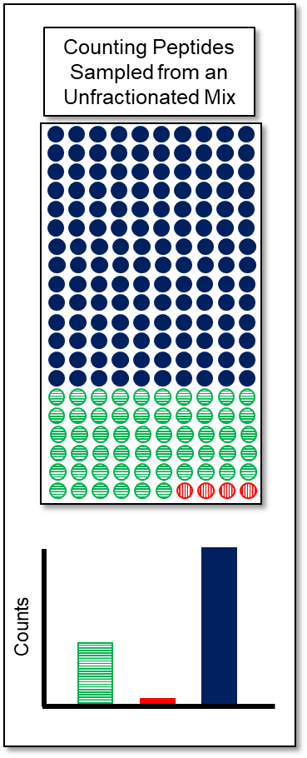
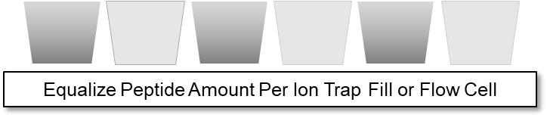
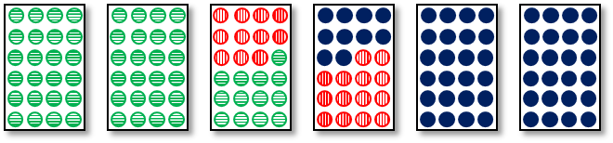
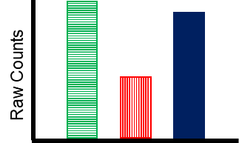
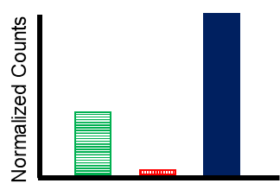
It better to group by each molecule type and count in aggregate
RAW Counts and Normalized Counts based on Peptide Load

Slide 34
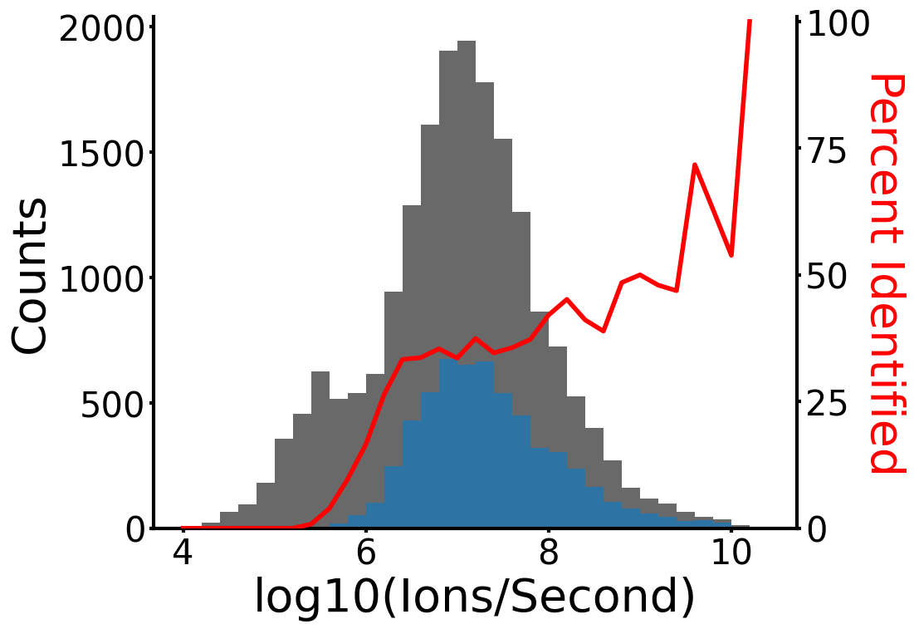
Lots of room for improvement!

Slide 35
Conclusions
Proteomics is orders of magnitude more challenging than transcriptomics.
Methods used successfully for transcriptomics can’t scale 25,000x without substantial improvements in flow cells, a paradigm shift in wideview microscopy, incorporation of separations and solution based AGC methods, etc…
1 billion reads costs ~$10,000 by Illumina, whereas 1 billion peptide ions costs ~$100
Single molecule methods based on flow cells will require costly reagents that will have lot to lot variability
Nanopores only analyze 10⁷ nucleotides (2 days), require 1 million times more sample than analyzed
LC-MS/MS is substantially more efficient at counting peptides than Illumina, Oxford Nanopore, PacBio, etc… are at counting nucleotides.

